Slide 1
Lecture 13: Review

Slide 2
Homework #5 Review

Slide 3
Problem #1
Output Window
_o_o_o1
_o_o_22
_o_o333
_o_4444
_o55555
_666666
7777777
int width = 7;
for (int row = 1; row <= width; row++)
{
int maxChar = width - row;
int maxNum = row;
for (int column = 1; column <= maxChar; column++)
{
if (column % 2 == 1)
S.O.P("_");
else
S.O.P("o");
}
for (int column = 1; column <= maxNum; column++)
{
S.O.P(row);
}
S.O.P.L();
}
Memory
width: 7
row: 1 2 3 4 5 6 7
maxChar: 6 5 4 3 2 1 0
maxNum: 1 2 3 4 5 6 7
column: 1 2 3 4 5 6 7
column: 1 2
column: 1 2 3 4 5 6
column: 1 2 3
column: 1 2 3 4 5
column: 1 2 3 4
column: 1 2 3 4
column: 1 2 3 4 5
column: 1 2 3
column: 1 2 3 4 5 6
column: 1 2
column: 1 2 3 4 5 6 7
column: 1
column: 1 2 3 4 5 6 7 8

Slide 4
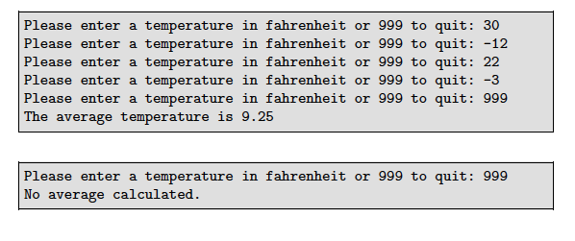
Problem #2
temp: double
average: double
sum: double
numTemps: integer
while loop or for-loop?
Either, but a while loop lends itself to a problem where you don’t know when to end.

Slide 5

double average = 0, sum = 0, temp = 0;
int numTemps = 0;
S.O.P(“Enter a temperature in fahrenheit or 999 to quit: “);
temp = kb.nextDouble();
while (temp != 999)
{
sum += temp;
numTemps++;
S.O.P(“Enter a temperature in fahrenheit or 999 to quit: “);
temp = kb.nextDouble();
}
average = sum/numTemps;
S.O.P.L(“The average temperature is ” + average);
Does this match all the sample output?
No. It may be helpful to have an eraser handy.

Slide 6
double average = 0, sum = 0, temp = 0;
int numTemps = 0;
S.O.P(“Enter a temperature in fahrenheit or 999 to quit: “);
temp = kb.nextDouble();
while (temp != 999)
{
sum += temp;
numTemps++;
S.O.P(“Enter a temperature in fahrenheit or 999 to quit: “);
temp = kb.nextDouble();
}
if (numTemps == 0)
S.O.P.L(“No average calculated”);
else
{
average = sum/numTemps;
S.O.P.L(“The average is ” + average);
}

Slide 7
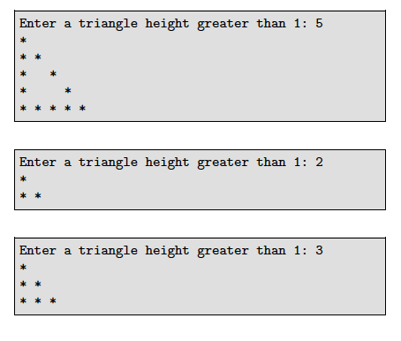
Problem #3
height: integer
Notes:
- Always have a star in the first column
- Always have a star in the last column
- Have all stars in the last row.
- The last row is equal to the height.
- The 1st row has 1 char, 2nd row has 2 chars, 3rd row has 3 chars, ...,
while loop or for-loop?
Either, but a for loop lends itself to a problem where you know when to stop.
Nested? Yes, rows and columns.

Slide 8
int height = 0;
S.O.P(“Enter a triangle height greater than 1: “);
height = kb.nextInt();
for (int row = 1; row <= height; row++)
{
for (int col = 1; col <= row; col++)
{
if (col == 1 || col == row)
S.O.P.L(“*”);
else
S.O.P.L(“ ”);
}
S.O.P.L();
}
Does this match the sample output?
No.

Slide 9
int height = 0;
S.O.P(“Enter a triangle height greater than 1: “);
height = kb.nextInt();
for (int row = 1; row <= height; row++)
{
for (int col = 1; col <= row; col++)
{
if (col == 1 || col == row || row == height)
S.O.P.L(“*”);
else
S.O.P.L(“ ”);
}
S.O.P.L();
}

Slide 10
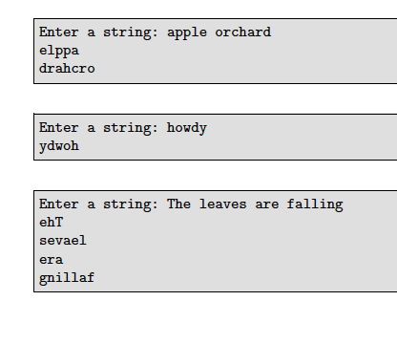
Problem #4
msg: String
Notes:
- Search until you find a space or the end of the sentence.
- The end of the sentence is length() - 1 - The beginning of the sentence is 0 - charAt()
while loop or for-loop?
Both.
Nested? Outer loop to walk through the String from beginning to end. Inner loop to walk backwards through each word.

Slide 11
String msg;
S.O.P("Enter a string: ");
msg = kb.nextLine();
int end = msg.length() - 1;
for (int i = 0; i <= end; i++)
{
if (msg.charAt(i) == ' ')
{
int j = i - 1;
while (j >= 0 && msg.charAt(j) != ' ')
{
S.O.P(msg.charAt(j));
j--;
}
S.O.P.L();
}
else if (i == end)
{
int j = i;
while (j >= 0 && msg.charAt(j) != ' ')
{
S.O.P(msg.charAt(j));
j--;
}
S.O.P.L();
}
}
Test Space

Slide 12
Practice Midterm Review

Slide 13


Problem #1
n: int
product: int
Notes:
- If it’s not the last number, print out each number with a star
- Don’t print a star for the last number
- Keep track of the product
while loop or for-loop?
Either.
Nested? No.

Slide 14
Test Space
int n;
int product = 1;
S.O.P("Enter n: ");
n = kb.nextInt();
for (int count = 1; count <= n; count++)
{
if (count != n)
S.O.P(count + “*”);
else
S.O.P(count);
product *= count;
}
S.O.P.L(“ is “ + product);

Slide 15
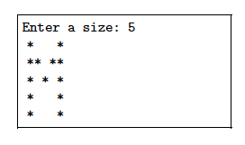
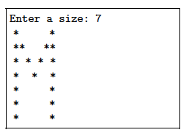
Problem #2
size: int
Notes:
- A star in the first and the last column for every row.
- Stars on the diagonal for everything from the second row up through the middle row.
while loop or for-loop?
for loop. We know our stop and start.
Nested? Yes - rows and columns.

Slide 16
int size;
S.O.P("Enter a size: ");
size = kb.nextInt();
for (int row = 1; row <= size; row++)
{
for (int col = 1; col <= size; col++)
{
if (col == 1 || col == size)
S.O.P("*");
else if (row > 1 && row <= (size/2 + 1))
{
if (col == row || col == (size - row + 1))
S.O.P("*");
else
S.O.P(" ");
}
else
S.O.P(" ");
}
S.O.P.L();
}
Test Space

Slide 17



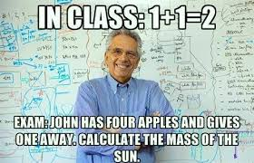
Study for your midterm!!!

